Slide 1
MOHA Annual Meeting Mountain Oaks Homeowners Association December 11, 2012
Welcome Homeowners!
www.mountainoakshoa.org

Slide 2
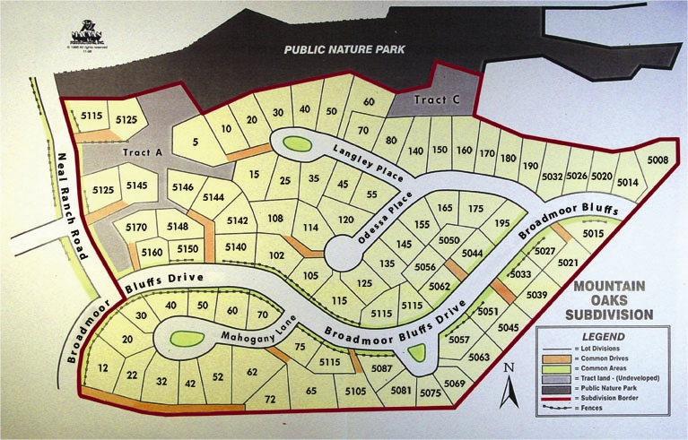
OUR HOMES, OUR COMMUNITY, OUR SHARED RESPONSIBILITY!

Slide 3
2012 Board of Directors
President Ronald Monesmith
Vice-President Vince DeSandro
Treasurer Dave Parks
Secretary Beverly Collins
Member-At-Large Steve Carmichall

Slide 4
2012 MOHA Annual Meeting Agenda
Call to order –Vince DeSandro 7:00 PM
Opening remarks
Major activities/issues, accomplishments
Wild land Fuel Program
Finance Report for 2012– Dave Parks 7:15 PM
Presentation of 2013 proposed budget; discussion
Vote on new budget
Maintenance/Arch. Control – Steve Carmichall 7:45PM
Vice-President Report – Vince DeSandro 8:00 PM
Landscaping/snow removal/maintenance service
Xeriscaping
Election of 2013 MOHA Board ` 8:30: PM
Nominations from floor and prior to meeting – need one new board member
Closed voting
Announcement of 2013 Board
Adjourn Meeting 9:00 PM
Notes:
4

Slide 5
2012 Activities and Accomplishments
2012 Dues Increased to $325
No legal activities in 2012
Switzer Landscaping for common area maintenance/snow removal continues
Islands repaired and maintained
Several Mail posts repaired

Slide 6
2012 Activities and Accomplishments
Mail Box Posts 2 Mail Box Posts Replaced – Reflectors Installed
Diligent Attention to Lawn Maintenance and Architectural Control
Email Communication - MOHA went green
Continuing effort to obtain all Email Accounts to save postage

Slide 7
2012 Wild land Fuel Mitigation Program
2012 Wild land Fuel Mitigation activities
2012 was MOHA’s fifth year of participation in program
Free chipping service provided September 2012
Good Turnout Reported
Continued Participation Reduces Wild Fire Hazard
Push to Increase Homeowner Participation
Increased Communication with Colorado Springs Fire Department
Wild land Fuel Program Coordinator – Andrew Notbohm, ANotbohm@springsgov.com, 719-385-7342
Notes:
7

Slide 8
2012 Financial Report
Annual HOA membership dues
$325
$27,350 in dues Received for 2012
Significantly reduced number of Late Payments
Individuals with Financial Hardship encouraged to contact Mr. Dave Parks

Slide 9
2012 Finance Summary YTD
MOHA Finance summary 2012
Checking Beginning Balance $ 14531.44
Savings Beginning Balance $ 6967.15
HOA dues $ 27350.00
Miscellaneous Income $ 350.00
Expense $(21834.74)
Balance $ 20396.70
Checking $ 20396.70
Savings $ 6986.65

Slide 10
MOHA 2012 Budget

Slide 11
2013 Proposed Budget (if n o dues increase)

Slide 12
Water and Landscaping 2012
Addressing Future Water and Maintenance Issues
Currently Consumes $18113, or 66% of Annual Budget (2011, it was 56%)
COS utilities (Water and Power)
Lawn maintenance
Sprinkler repairs
“The water rates will increase 10 to 12 percent a year through 2017.” *
* http://www.coloradoconnection.com/news/story.aspx?list=196197&id=328565#.Tt2FP1b-uSo

Slide 13
Maintenance and Architectural Control
Maintenance
Common areas
Snow removal – MOHA will adhere to “4- inch of snow” removal rule
Landscaping/yard maintenance
Several Architectural control requests received in 2012
Many Homes Painted, Re-roofed due to 2012 Hail Storm
2 Mail box Post Replacements
House painting, new roofs, decking, landscaping, expansion of driveways, tree removal and fencing requests MUST be approved by MOHA board

Slide 14
MOHA 2013 Board of Directors Nominations
Request for Open Election for 2012 Officers
Existing nominations for new board member(received prior to 12/11/12)
Vince DeSandro
Dave Parks
Steve Carmichall
Beverly Collins
Nominations and vote based on Individual Ballots and/or Proxy's
Election of officers
10% of MOHA constitutes a quorum

Slide 15
MOHA 2013 Board of Directors And Xeriscaping Project Volunteers
Election of MOHA Board Officers for 2013 Announced

Slide 16
QUESTIONS and COMMENTS
Our Homes,
Our Community,
Our Shared Responsibility
Thank You For Attending

